Slide 1
Special days of our school
King Mathias Grammar School - Fonyód

Slide 2
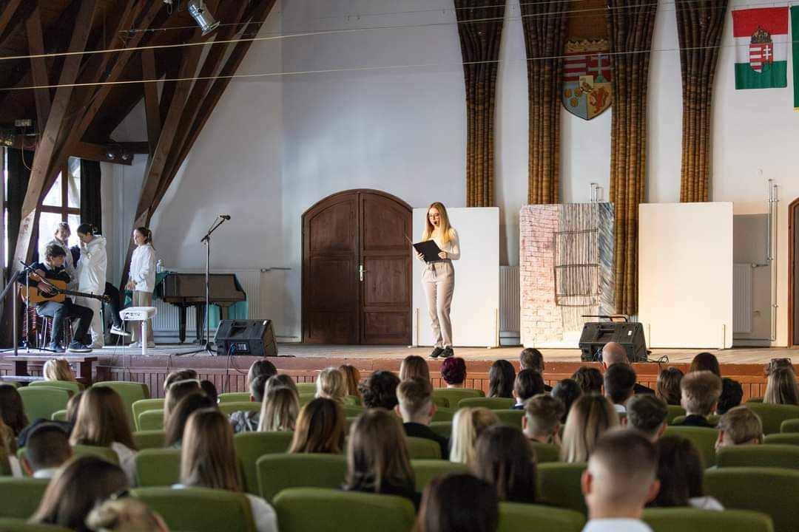
On 23rd October, we commemorate the 1956 revolution and the fight for freedom. It is a national holiday in our country and every year in our school we commemorate it with a short performance. Students have to wear their school uniforms.

Slide 3
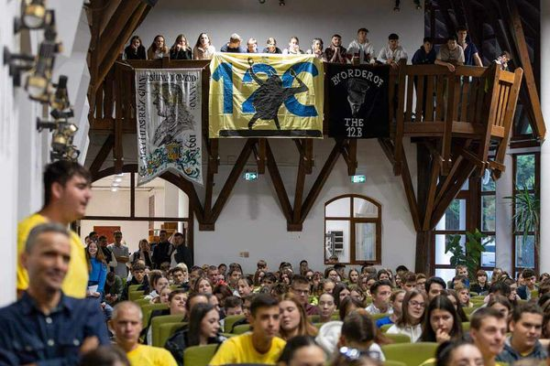
In November we have a student’s day when we have elections for the position of the Student Director. Classes perform on stage and we do lots of fun activities.

Slide 4
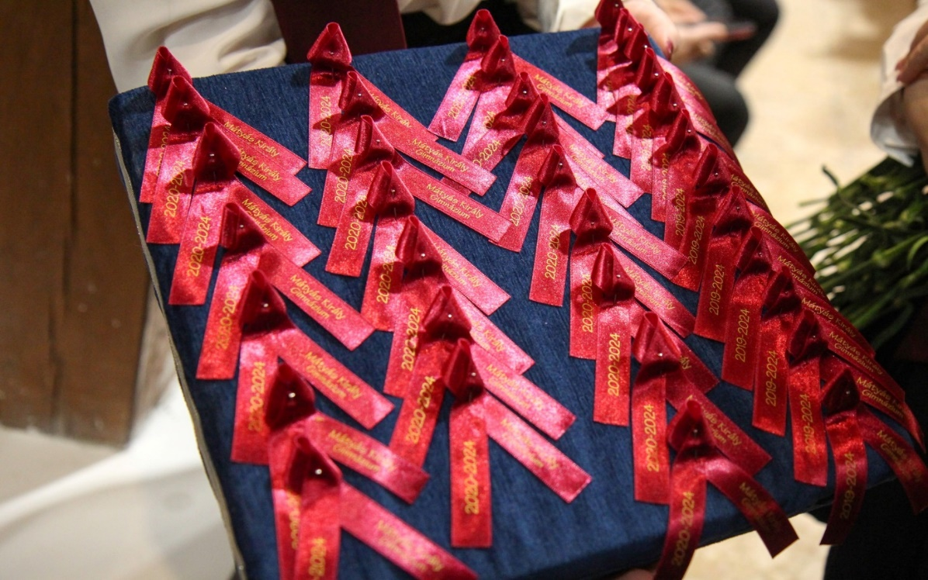
The ribbon giving ceremony is organized in the first half of our school year. All the graduate students get a ribbon pinned to their shirt by their own head theacher,who also gets a ribbon. The ribbon is another memory that they get. The name of our school and the year when they started and finished school is printed on it.

Slide 5
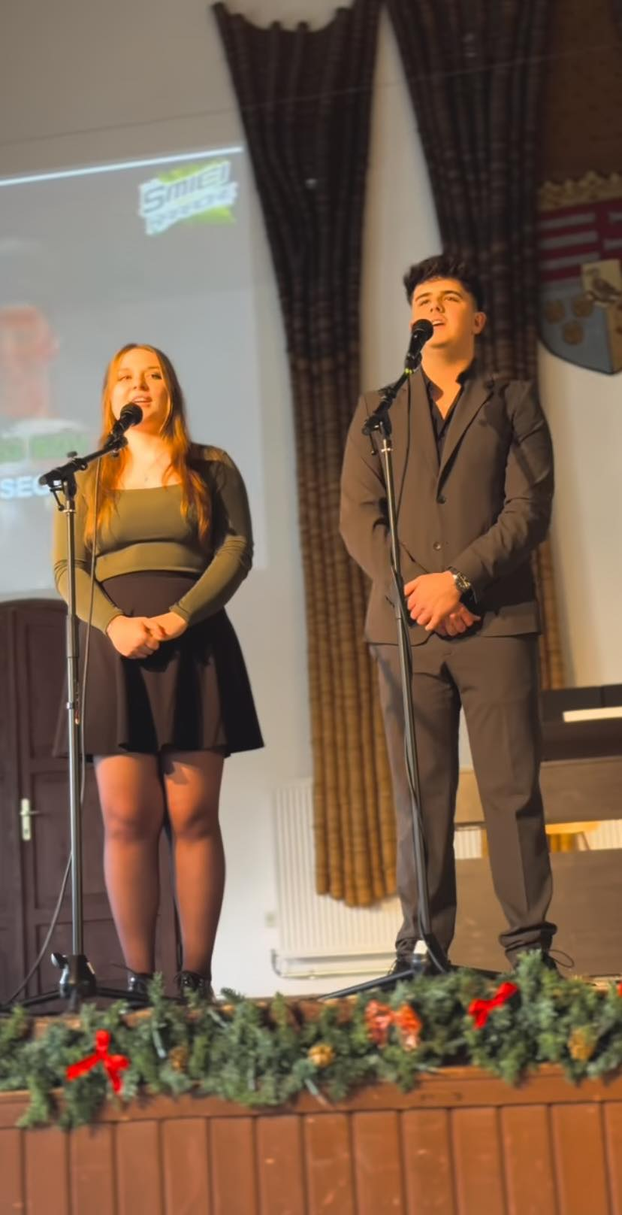
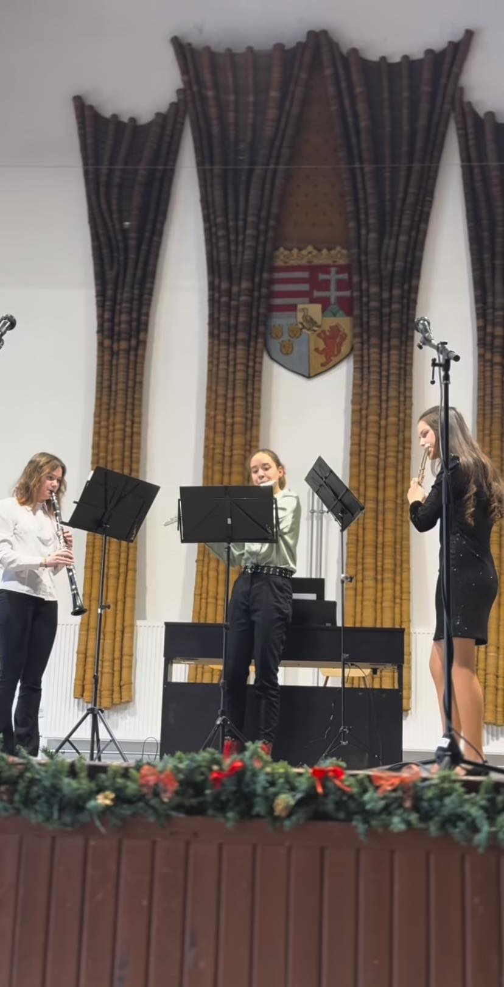
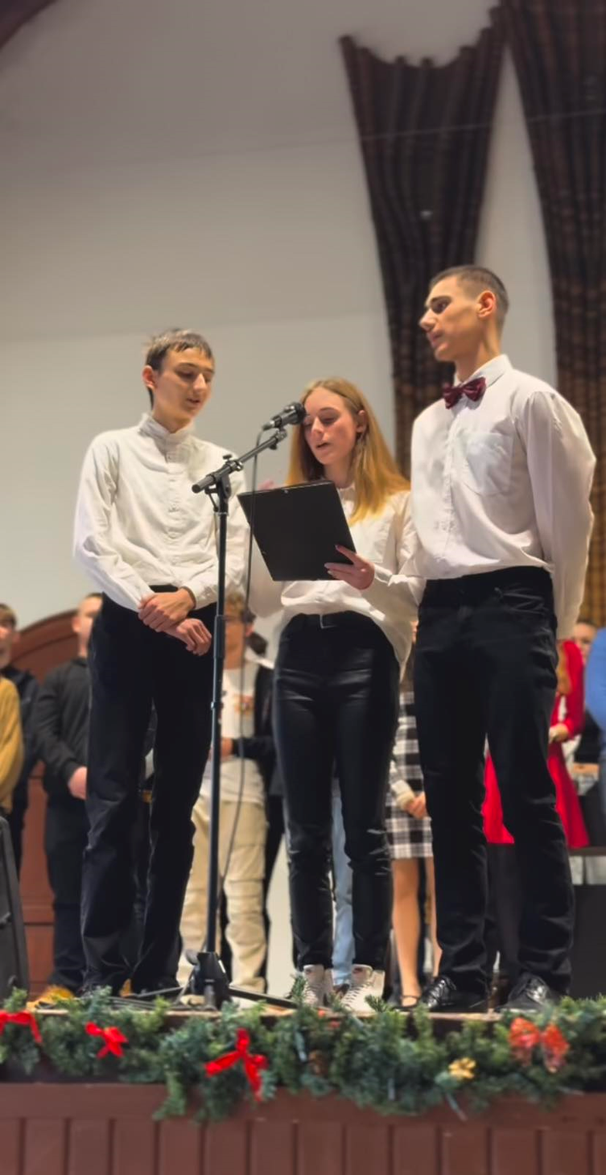
The Christmas concert is a traditional celebration at our school. We hold it on the last day before the winter break. There are no lessons on this day. The concert is given by the talented students. They sing and play instruments.

Slide 6
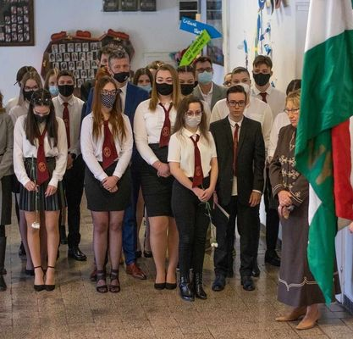
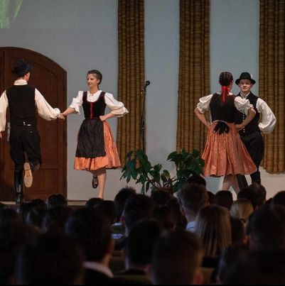
Mathias Day - We celebrate the name of our school on this day.In the morning there is an official ceremony. After that students take part in freely chosen programs, like a music workshop or different lectures.

Slide 7
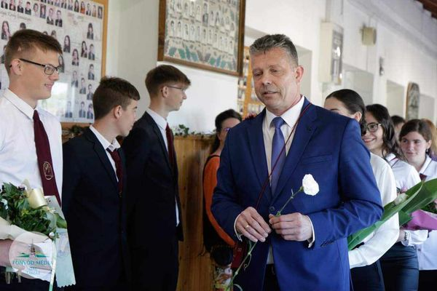
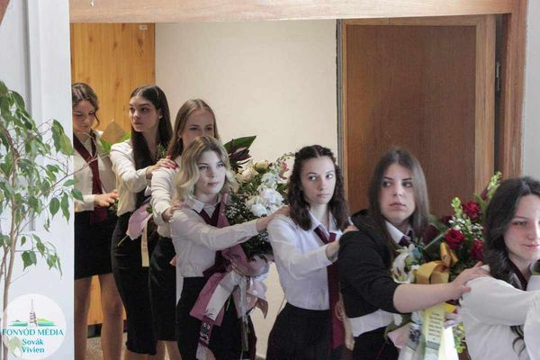
Shool leaving ceremony is in the end of April. School leavers sing traditional songs and walk around the school to say goodbye to their teachers and schoolmates. At the end is an official ceremony. After this event starts the Matura examination.

Slide 8
Thank you for your attention

